Slide 1
Unit I – Introduction & Cloud Computing Architecture

Slide 2
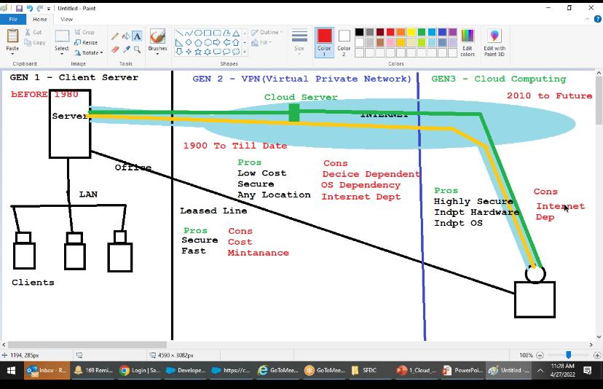

Slide 3
1. Cloud computing at a glance:
In 1969, Leonard Kleinrock, one of the chief scientists of the original Advanced Research Projects Agency Network (ARPANET), which seeded the Internet, said:
“As of now, computer networks are still in their infancy, but as they grow up and become sophisticated, we will probably see the spread of ‘computer utilities’ which, like present electric and telephone utilities, will service individual homes and offices across the country”.

Slide 4
This vision of computing utilities based on a service-provisioning model anticipated the massive transformation of the entire computing industry in the 21st century, whereby computing services will be readily available on demand, just as other utility services such as water, electricity, telephone, and gas are available in today’s society.
Similarly, users (consumers) need to pay providers only when they access the computing services.
In addition, consumers no longer need to invest heavily or encounter difficulties in building and maintaining complex IT infrastructure.

Slide 5
In such a model, users access services based on their requirements without regard to where the services are hosted. This model has been referred to as utility computing or, recently (since 2007), as cloud computing.
Cloud computing allows renting infrastructure, runtime environments, and services on a pay-per-use basis.
End users leveraging cloud computing services can access their documents and data anytime, anywhere, and from any device connected to the Internet.

Slide 6
Many other points of view exist. One of the most diffuse views of cloud computing can be summarized as follows:
I don’t care where my servers are, who manages them, where my documents are stored, or where my applications are hosted. I just want them always available and access them from any device connected through Internet. And I am willing to pay for this service for as a long as I need it.

Slide 7
Web 2.0 technologies play a central role in making cloud computing an attractive opportunity for building computing systems.
Service orientation allows cloud computing to deliver its capabilities with familiar abstractions, while virtualization confers on cloud computing the necessary degree of customization, control, and flexibility for building production and enterprise systems.

Slide 8
1.1 The vision of cloud computing
Cloud computing allows anyone with a credit card to provision virtual hardware, runtime environments, and services. These are used for as long as needed, with no up-front commitments required.
The entire stack of a computing system is transformed into a collection of utilities, which can be provisioned and composed together to deploy systems in hours rather than days and with virtually no maintenance costs.
This opportunity has now become a practice across several application domains and business sectors (see Figure 1.1).
The demand has fast-tracked technical development and enriched the set of services offered, which have also become more sophisticated and cheaper.

Slide 9
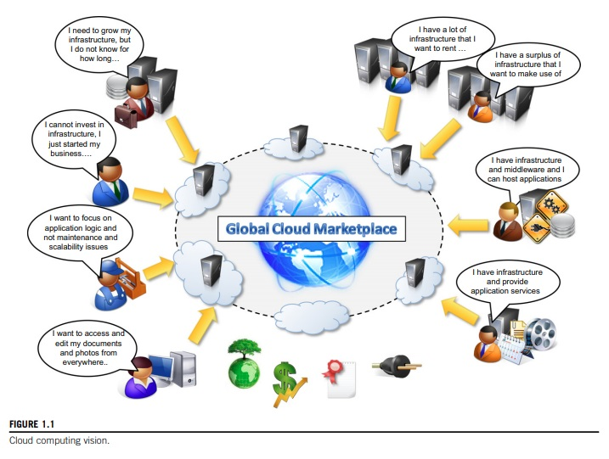

Slide 10
1.2 Defining a cloud:
Cloud computing has become a popular buzzword; it has been widely used to refer to different technologies, services, and concepts.
It is often associated with virtualized infrastructure or hardware on demand, utility computing, IT outsourcing, platform and software as a service, and many other things that now are the focus of the IT industry.
Figure 1.2 depicts the plethora of different notions included in current definitions of cloud computing.
The term cloud has historically been used in the telecommunications industry as an abstraction of the network in system diagrams.
It then became the symbol of the most popular computer network: the Internet. This meaning also applies to cloud computing, which refers to an Internet-centric way of computing.

Slide 11
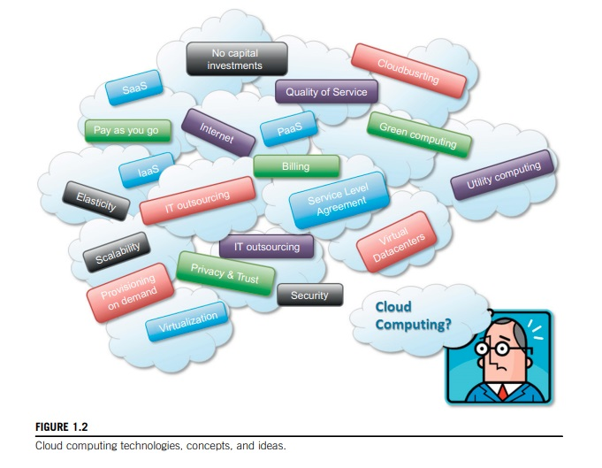

Slide 12
The Internet plays a fundamental role in cloud computing, since it represents either the medium or the platform through which many cloud computing services are delivered and made accessible. This aspect is also reflected in the definition given by Armbrust et al. [28]:
Cloud computing refers to both the applications delivered as services over the Internet and the hardware and system software in the data centers that provide those services.

Slide 13
This definition describes cloud computing as a phenomenon touching on the entire stack: from the underlying hardware to the high-level software services and applications. It introduces the concept of everything as a service, mostly referred as XaaS, where the different components of a system—IT infrastructure, development platforms, databases, and so on—can be delivered, measured, and consequently priced as a service.
A definition proposed by the U.S. National Institute of Standards and Technology (NIST): Cloud computing is a model for enabling ubiquitous, convenient, on-demand network access to a shared pool of configurable computing resources (e.g., networks, servers, storage, applications, and services) that can be rapidly provisioned and released with minimal management effort or service provider interaction.

Slide 14
Another important aspect of cloud computing is its utility-oriented approach. More than any other trend in distributed computing, cloud computing focuses on delivering services with a given pricing model, in most cases a “pay-per-use” strategy.
It makes it possible to access online storage, rent virtual hardware, or use development platforms and pay only for their effective usage, with no or minimal up-front costs.
All these operations can be performed and billed simply by entering the credit card details and accessing the exposed services through a Web browser.
This helps us provide a different and more practical characterization of cloud computing.

Slide 15
According to Reese [29], we can define three criteria to discriminate whether a service is delivered in the cloud computing style:
The service is accessible via a Web browser (non-proprietary) or a Web services application programming interface (API).
Zero capital expenditure is necessary to get started.
You pay only for what you use as you use it.

Slide 16
1.3 A closer look:
Cloud computing is helping enterprises, governments, public and private institutions, and research organizations shape more effective and demand-driven computing systems. Access to, as well as integration of, cloud computing resources and systems is now as easy as performing a credit card transaction over the Internet.
Cloud computing does not only contribute with the opportunity of easily accessing IT services on demand, but it also introduces a new way of thinking about IT services and resources: as utilities.
A bird’s-eye view of a cloud computing environment is shown in Figure 1.3.

Slide 17
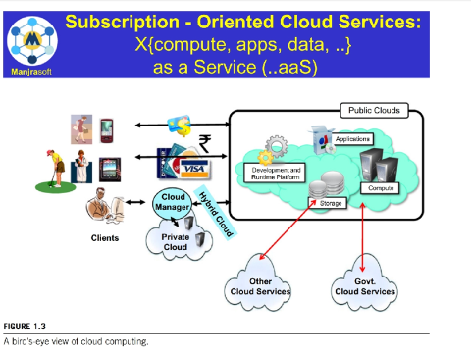

Slide 18
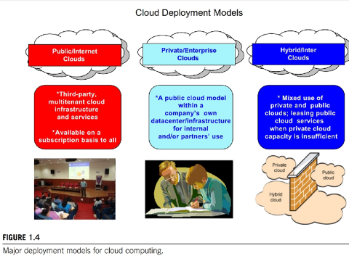
The three major models for deploying and accessing cloud computing environments are public clouds, private/enterprise clouds, and hybrid clouds (see Figure 1.4).

Slide 19
1.4 The cloud computing reference model:
Each layer provides a different service to users.
IaaS solutions are sought by users who want to leverage cloud computing from building dynamically scalable computing systems requiring a spe- cific software stack. IaaS services are therefore used to develop scalable Websites or for back- ground processing.
PaaS solutions provide scalable programming platforms for developing applications and are more appropriate when new systems have to be developed.
SaaS solutions target mostly end users who want to benefit from the elastic scalability of the cloud without doing any software development, installation, configuration, and maintenance. This solution is appropriate when there are existing SaaS services that fit users needs (such as email, document management, CRM, etc.) and a minimum level of customization is needed.

Slide 20
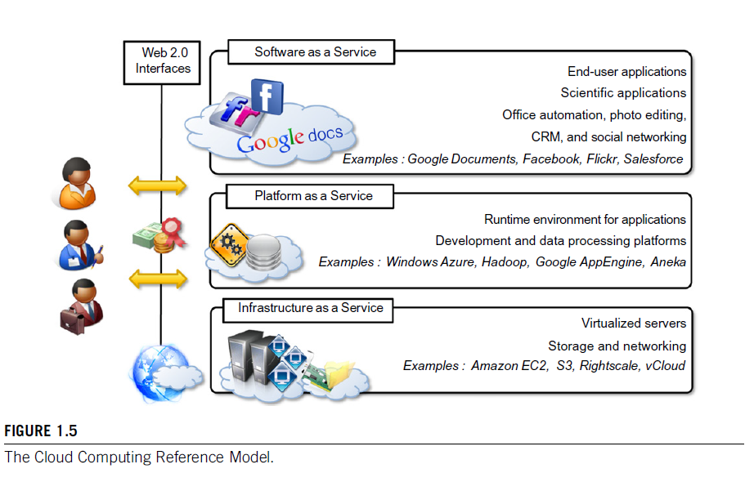

Slide 21
1.5 Characteristics and benefits
Cloud computing has some interesting characteristics that bring benefits to both cloud service con- sumers (CSCs) and cloud service providers (CSPs).
These characteristics are:
No up-front commitments
On-demand access
Nice pricing
Simplified application acceleration and scalability
Efficient resource allocation
Energy efficiency
Seamless creation and use of third-party services

Slide 22
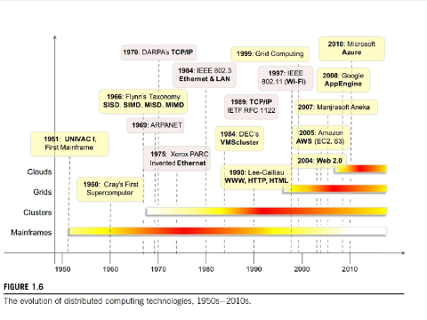

Slide 23
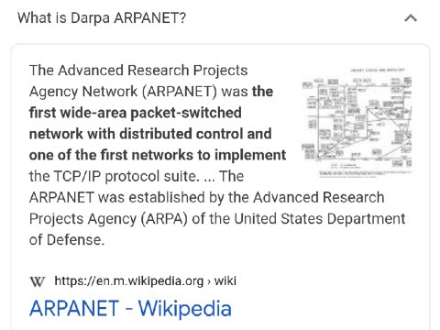

Slide 24
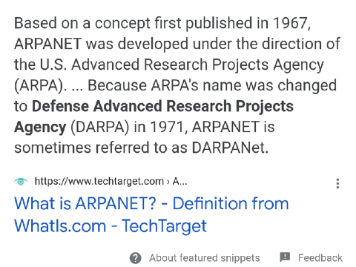

Slide 25
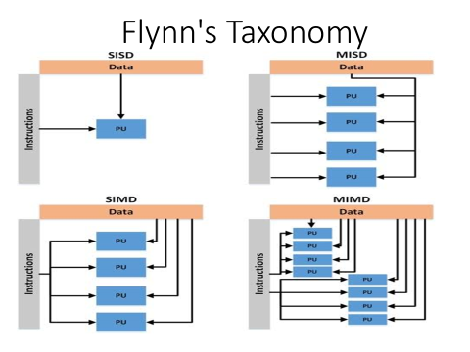

Slide 26
GAP
……

Slide 27
3. Web 2.0 Technology
Web 2.0 is a term that describes the changing trends in the use of Web technology and Web design that aim to enhance creativity, secure information sharing, increase collaboration, and improve the functionality of the Web.
Examples: Web 2.0 supports the creation of self-publishing platforms like WordPress, as well as social media sites. Examples of Web 2.0 sites include Wikipedia, Facebook, Twitter, and web blog sites, which all transformed the way the same information was shared and delivered.

Slide 28
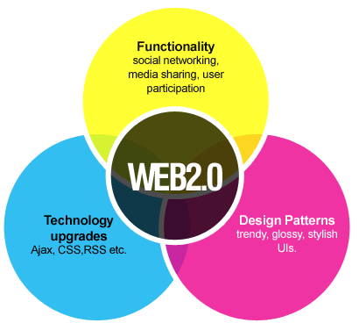
Web 2.0 Technology

Slide 29
RSS
https://solvid.co.uk/rss-feed-explained/
https://flatworldbusiness.wordpress.com/flat-education/previously/web-1-0-vs-web-2-0-vs-web-3-0-a-bird-eye-on-the-definition/

Slide 30
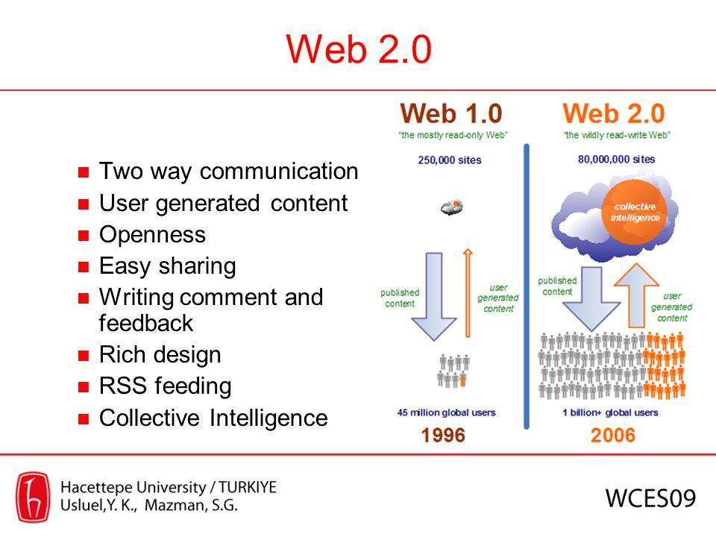

Slide 31
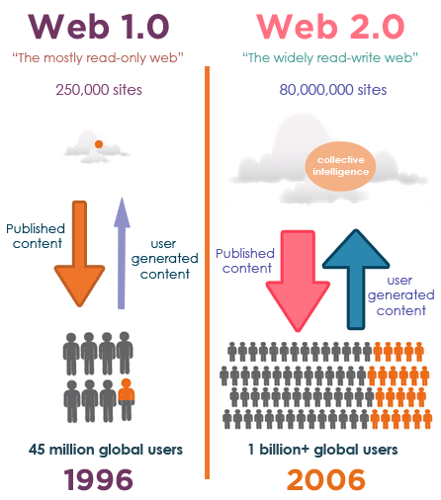

Slide 32
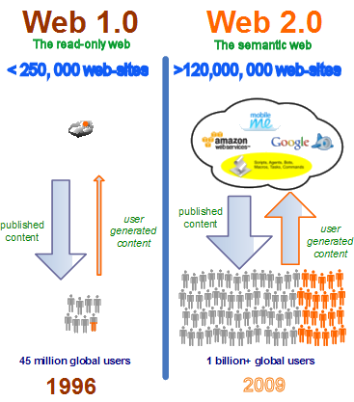

Slide 33
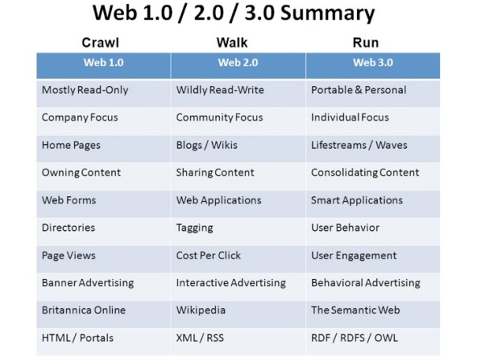

Slide 34
4. Service Oriented Computing
Service-oriented computing (SOC) is the computing paradigm that utilizes services as fundamental elements for developing applications/solutions.
Service orientation is the core reference model for cloud computing systems.
A service is supposed to be reusable, programming language independent.

Slide 35
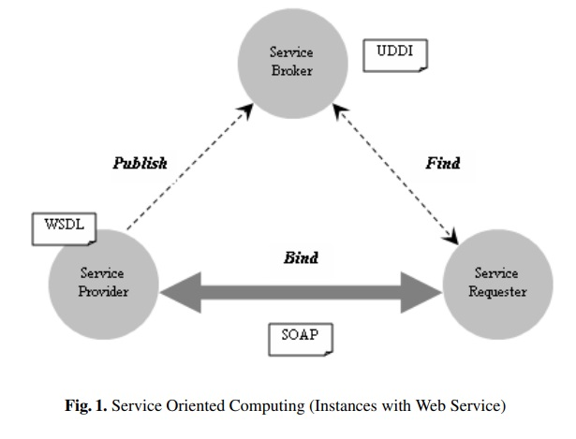
Service Oriented Computing
A service is advertised in a public registry through Publish operation.
A service requester (user) communicates with service broker through Find operation to select the most appropriate service to satisfy specific requirements.
Further, the Service requester interacts with the concerned service provider through Bind operation and uses the service.

Slide 36
5. Utility oriented computing
Utility computing is a model in which computing resources are provided to the customer based on specific demand.
The foundational concept is that users or businesses pay the providers of utility computing for the amenities used – such as computing capabilities, storage space and applications services.
They are called utility services because they function similarly to utilities like electricity and water. Pay for the amount you use, rather than a flat monthly fee to access the network.

Slide 37
Cloud Computing Technology – Virtualization, SOA, Grid, Utility Computing
For more information visit:
https://data-flair.training/blogs/cloud-computing-technology/

Slide 38
Cont..
https://slideplayer.com/slide/13501163/

Slide 39
Unit I-Part 2: Cloud Computing Architecture
Introduction
The cloud reference model
Types of clouds
Economics of the cloud
Open challenges

Slide 40
I. Introduction
Utility-oriented data centers are the first outcome of cloud computing, and they serve as the infrastructure through which the services are implemented and delivered.
As noted in earlier chapters, the cloud computing paradigm emerged as a result of the convergence of various existing models, technologies, and concepts that changed the way we deliver and use IT services. A broad definition of the phenomenon could be as follows:
Cloud computing is a utility-oriented and Internet-centric way of delivering IT services on demand. These services cover the entire computing stack: from the hardware infrastructure packaged as a set of virtual machines to software services such as development platforms and distributed applications.
This definition captures the most important and fundamental aspects of cloud computing. We now discuss a reference model that supports in categorization of cloud technologies, applications, and services.

Slide 41
II. The cloud reference model
Cloud computing supports any IT service that can be consumed as a utility and delivered through a network, most likely the Internet. Such characterization includes quite different aspects: infrastructure, development platforms, application and services.
Architecture: It is possible to organize all the concrete realizations of cloud computing into a layered view covering the entire stack (see Figure 4.1), from hardware appliances to software systems.
Cloud resources are harnessed to offer “computing horsepower” required for providing services.
Cloud infrastructure can be heterogeneous in nature because a variety of resources, such as clusters and even networked PCs, can be used to build it. Moreover, database systems and other storage services can also be part of the infrastructure.

Slide 42
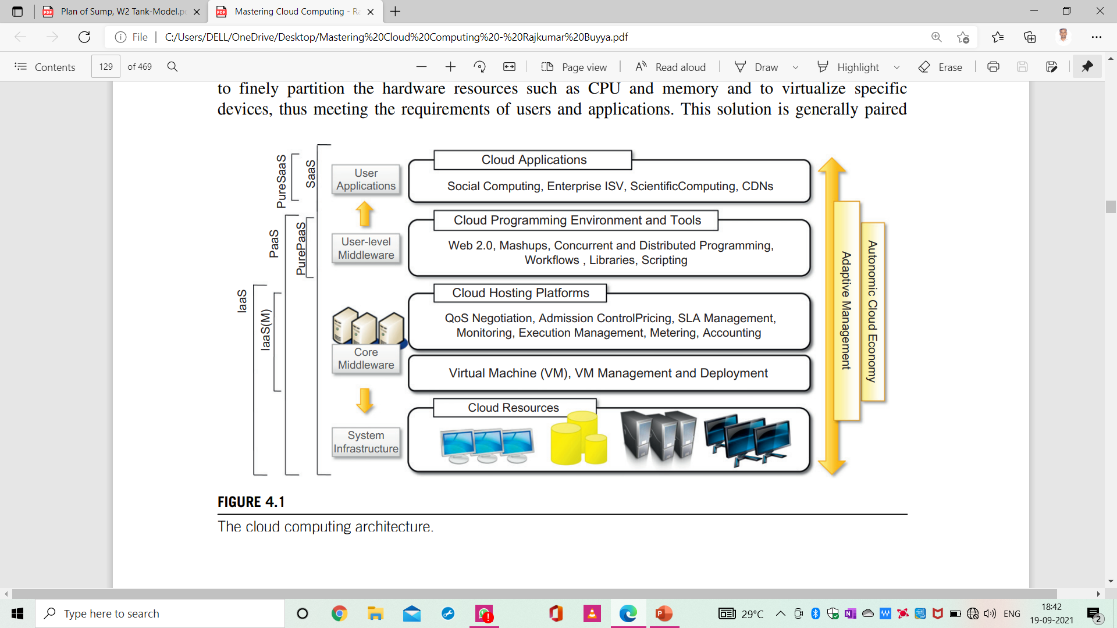
II. The cloud reference mode (cont..)
The physical infrastructure is managed by the core middleware, the objectives of which are to provide an appropriate runtime environment for applications and to best utilize resources.
At the bottom of the stack, virtualization technologies are used to guarantee runtime environment customization, application isolation, sandboxing, and quality of service. Hardware virtualization is most commonly used at this level. Hypervisors manage the pool of resources and expose the distributed infrastructure as a collection of virtual machines.

Slide 43
II. The cloud reference mode (cont..)
By using virtual machine technology it is possible to finely partition the hardware resources such as CPU and memory and to virtualize specific devices, thus meeting the requirements of users and applications.
According to the specific service offered to end users, other virtualization techniques can be used; for example, programming-level virtualization helps in creating a portable runtime environment where applications can be run and controlled.
This scenario generally implies that applications hosted in the cloud be developed with a specific technology or a programming language, such as Java, .NET, or Python.
The combination of cloud hosting platforms and resources is generally classified as a Infrastructure-as-a-Service (IaaS) solution.
We can organize the different examples of IaaS into two categories: Some of them provide both the management layer and the physical infrastructure; others provide only the management layer (IaaS (M)).
In this second case, the management layer is often integrated with other IaaS solutions that provide physical infrastructure and adds value to them.

Slide 44
II. The cloud reference mode (cont..)
IaaS solutions are suitable for designing the system infrastructure but provide limited services to build applications.
Such service is provided by cloud programming environments and tools, which form a new layer for offering users a development platform for applications.
The range of tools include Web-based interfaces, command-line tools, and frameworks for concurrent and distributed programming.
In this scenario, users develop their applications specifically for the cloud by using the API exposed at the user-level middleware. For this reason, this approach is also known as Platform-as-a-Service (PaaS) because the service offered to the user is a development platform rather than an infrastructure.
PaaS solutions generally include the infrastructure as well, which is bundled as part of the service provided to users. In the case of Pure PaaS, only the user-level middleware is offered, and it has to be complemented with a virtual or physical infrastructure.
The top layer of the reference model depicted in Figure 4.1 contains services delivered at the application level. These are mostly referred to as Software-as-a-Service (SaaS).
In most cases these are Web-based applications that rely on the cloud to provide service to end users.

Slide 45
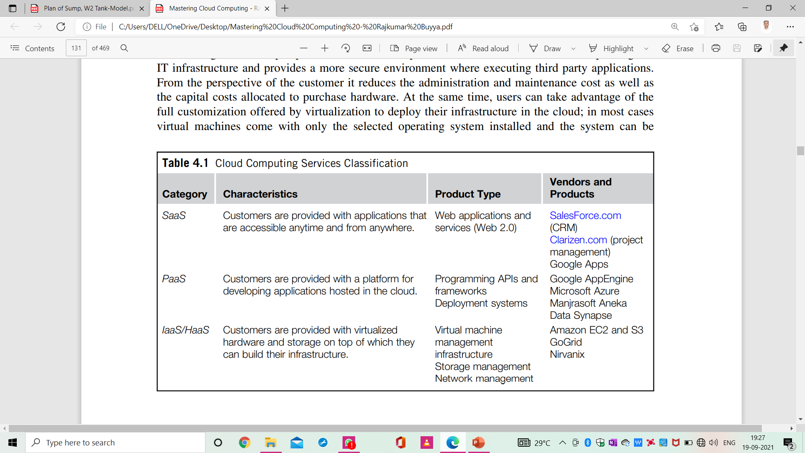
II. The cloud reference mode (cont..)
The reference model described in Figure 4.1 also introduces the concept of Everything as a Service (XaaS). This is one of the most important elements of cloud computing: Cloud services from different providers can be combined to provide a completely integrated solution covering all the computing stack of a system.
Table 4.1 summarizes the characteristics of the three major categories used to classify cloud computing solutions. In the following section, we briefly discuss these characteristics along with some references to practical implementations.

Slide 46
Infrastructure- and hardware-as-a-service
Infrastructure- and Hardware-as-a-Service (IaaS/HaaS) solutions are the most popular and developed market segment of cloud computing.
They deliver customizable infrastructure on demand. The available options within the IaaS offering umbrella range from single servers to entire infrastructures, including network devices, load balancers, and database and Web servers.
The main technology used to deliver and implement these solutions is hardware virtualization: one or more virtual machines fortunately configured and interconnected define the distributed system on top of which applications are installed and deployed.
IaaS/HaaS solutions bring all the benefits of hardware virtualization: workload partitioning, application isolation, sandboxing, and hardware tuning.
From the perspective of the service provider, IaaS/HaaS allows better exploiting the IT infrastructure and provides a more secure environment where executing third party applications.
From the perspective of the customer, it reduces the administration and maintenance cost as well as the capital costs allocated to purchase hardware.
At the same time, users can take advantage of the full customization offered by virtualization to deploy their infrastructure in the cloud; in most cases virtual machines come with only the selected operating system installed and the system can be configured with all the required packages and applications.

Slide 47
Infrastructure- and hardware-as-a-service (cont..)
Figure 4.2 provides an overall view of the components forming an Infrastructure-as-a-Service solution. It is possible to distinguish three principal layers: the physical infrastructure, the software management infrastructure, and the user interface.
At the top layer the user interface provides access to the services exposed by the software management infrastructure.
Such an interface is generally based on Web 2.0 technologies: Web services, RESTful APIs, and mash-ups.
These technologies allow either applications or final users to access the services exposed by the underlying infrastructure.
Web 2.0 applications allow developing full-featured management consoles completely hosted in a browser or a Web page.
Web services and RESTful APIs allow programs to interact with the service without human intervention, thus providing complete integration within a software system.

Slide 48
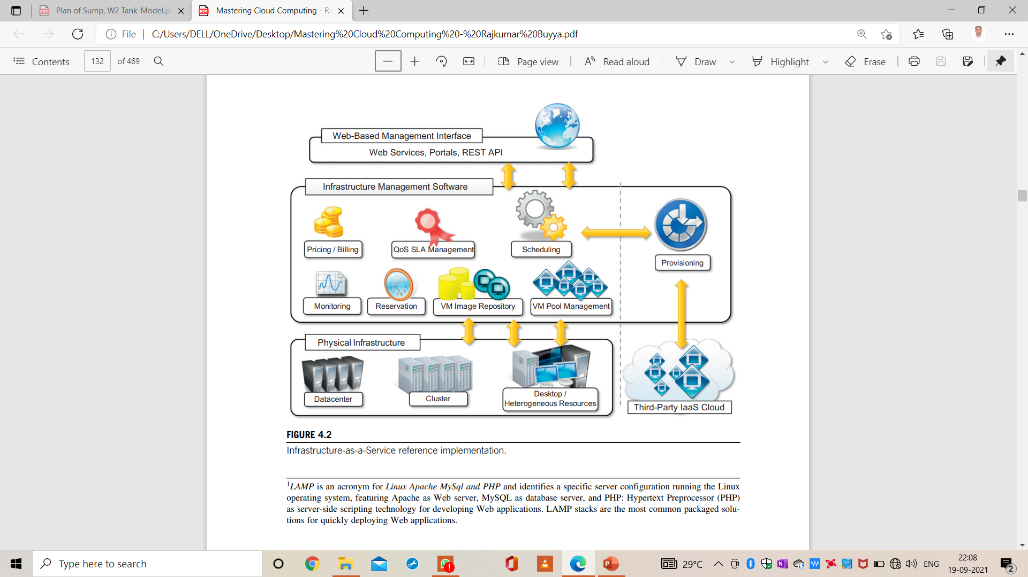
Infrastructure- and hardware-as-a-service (cont..)

Slide 49
Infrastructure- and hardware-as-a-service (cont..)
In particular, management of the virtual machines is the most important function performed by this layer.
A central role is played by the scheduler, which is in charge of allocating the execution of virtual machine instances. The scheduler interacts with the other components that perform a variety of tasks:
The pricing and billing component takes care of the cost of executing each virtual machine instance and maintains data that will be used to charge the user.
The monitoring component tracks the execution of each virtual machine instance and maintains data required for reporting and analyzing the performance of the system.
The reservation component stores the information of all the virtual machine instances that have been executed or that will be executed in the future.
If support for QoS-based execution is provided, a QoS/SLA management component will maintain a repository of all the SLAs made with the users; together with the monitoring component, this component is used to ensure that a given virtual machine instance is executed with the desired quality of service.

Slide 50
Infrastructure- and hardware-as-a-service (cont..)
The VM repository component provides a catalog of virtual machine images that users can use to create virtual instances. Some implementations also allow users to upload their specific virtual machine images.
A VM pool manager component is responsible for keeping track of all the live instances.
Finally, if the system supports the integration of additional resources belonging to a third-party IaaS provider, a provisioning component interacts with the scheduler to provide a virtual machine instance that is external to the local physical infrastructure directly managed by the pool.

Slide 51
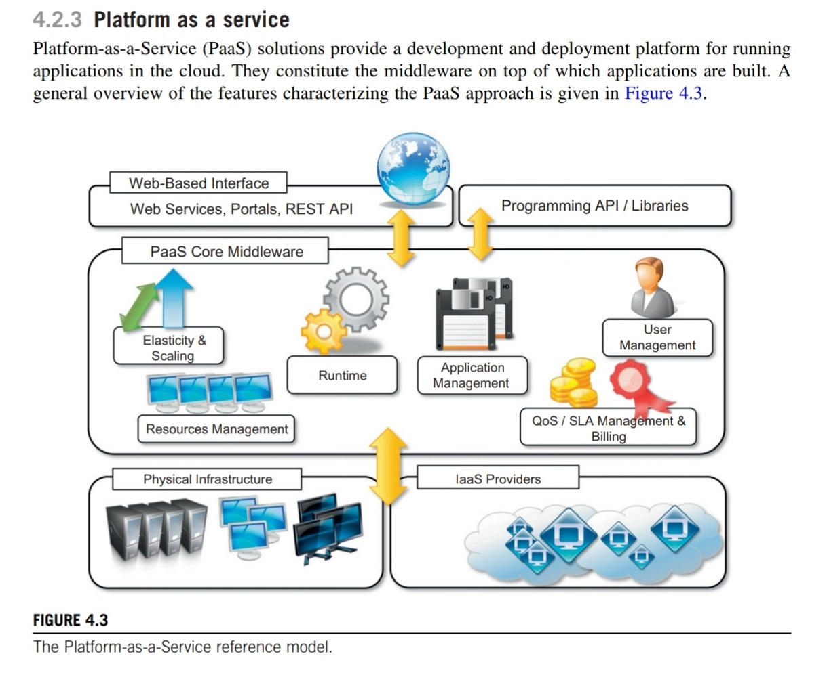

Slide 52
Essential characteristics that identify a PaaS solution:
Runtime framework. This framework represents the “software stack” of the PaaS model and the most intuitive aspect that comes to people’s minds when they refer to PaaS solutions. The runtime framework executes end-user code according to the policies set by the user and the provider.
Abstraction. PaaS solutions offer a way to deploy and manage applications on the cloud rather than a bunch of virtual machines on top of which the IT infrastructure is built and configured.
Automation. PaaS environments automate the process of deploying applications to the infrastructure, scaling them by provisioning additional resources when needed. This process is performed automatically and according to the SLA made between the customers and the provider.
Cloud services. PaaS offerings provide developers and architects with services and APIs, helping them to simplify the creation and delivery of elastic and highly available cloud applications. These services are the key differentiators among competing PaaS solutions and generally include specific components for developing applications, advanced services for application monitoring, management, and reporting.

Slide 53
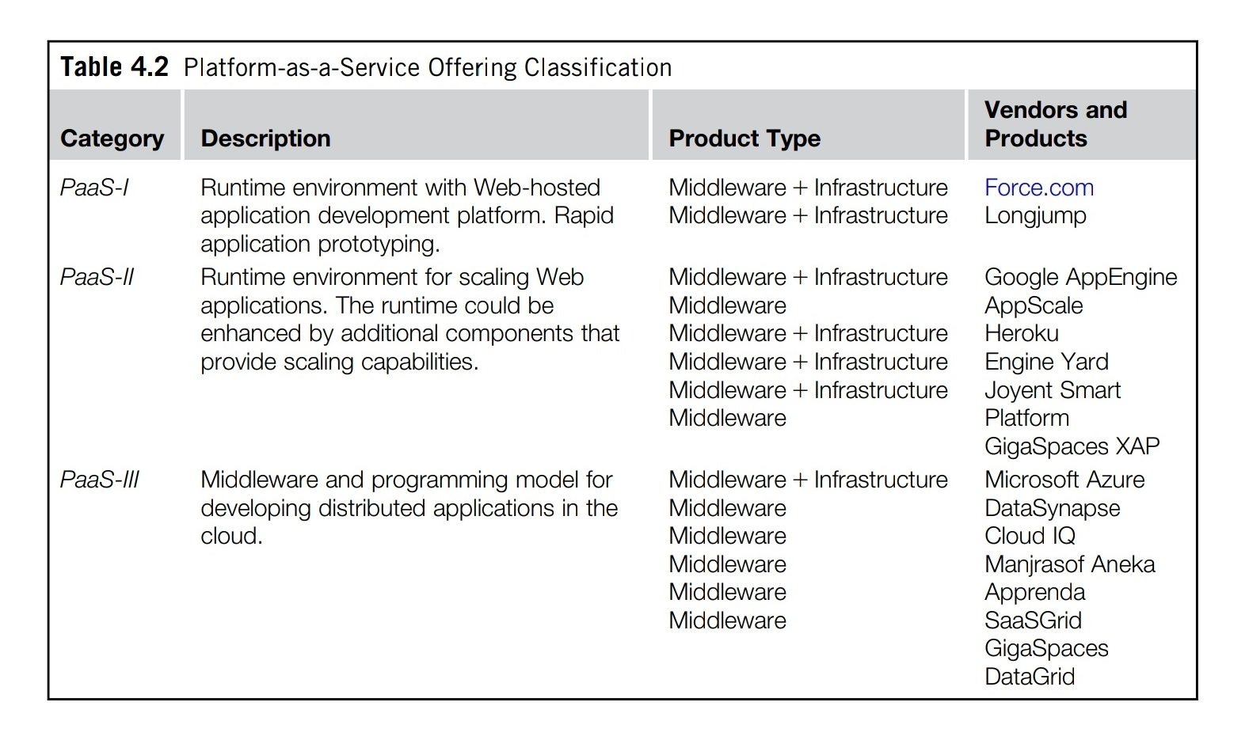

Slide 54
3. Software as a Service (SaaS)
Software-as-a-Service (SaaS) is a software delivery model that provides access to applications through the Internet as a Web-based service.
The SaaS model is attractive for applications serving a wide range of users and that can be adapted to specific needs with little further customization.
Every enterprise will have the same requirements for the basic features concerning CRM and ERP; different needs can be satisfied with further customization.
This scenario facilitates the development of software platforms that provide a general set of features and support specialization and ease of integrating new components.

Slide 55
3. Software as a Service (SaaS) (cont..)
The acronym SaaS was then coined in 2001 by the Software Information & Industry Association (SIIA) with the following connotation:
In the software as a service model, the application, or service, is deployed from a centralized datacenter across a network—Internet, Intranet, LAN, or VPN—providing access and use on a repetitive fee basis. Users “rent,” “subscribe to,” “are assigned,” or “are granted access to” the applications from a central provider. Business models vary according to the level to which the software is streamlined, to lower price and increase efficiency, or value-added through customization to further improve digitized business processes.

Slide 56
3. Software as a Service (SaaS) (cont..)
The analysis carried out by SIIA was mainly oriented to cover application service providers (ASPs) and all their variations, which capture the concept of software applications consumed as a service in a broader sense. ASPs already had some of the core characteristics of SaaS:
The product sold to customer is application access.
The application is centrally managed.
The service delivered is one-to-many.
The service delivered is an integrated solution, delivered on the contract which means provided as promised.

Slide 57
3. Software as a Service (SaaS) (cont..)
Initially the SaaS model was of interest only for prime users and early adopters. The benefits delivered at that stage were the following:
Software cost reduction and total cost of ownership (TCO) were paramount
Service-level improvements
Rapid implementation
Standalone and configurable applications
Rudimentary (Basic) application and data integration
Subscription and pay-as-you-go (PAYG) pricing

Slide 58
III. Types of clouds
Clouds build the infrastructure on top of which services are implemented and delivered to customers. Such infrastructures can be of different types and provide useful information about the nature and the services offered by the cloud.
It is then possible to differentiate four different types of cloud:
Public clouds
Private clouds
Hybrid or heterogeneous clouds
Community clouds

Slide 59
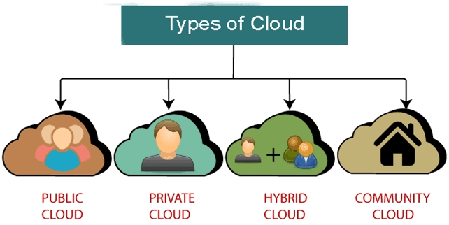

Slide 60
III. Types of clouds (cont..)
Public clouds: The cloud is open to the wider public.
Private clouds: The cloud is implemented within the private premises of an institution and generally made accessible to the members of the institution or a subset of them.
Hybrid or Heterogeneous clouds: The cloud is a combination of the two previous solutions and most likely identifies a private cloud that has been augmented (improved) with resources or services hosted in a public cloud.
Community clouds: The cloud is characterized by a multi-administrative domain involving different deployment models (public, private, and hybrid), and it is specifically designed to address the needs of a specific industry.

Slide 61
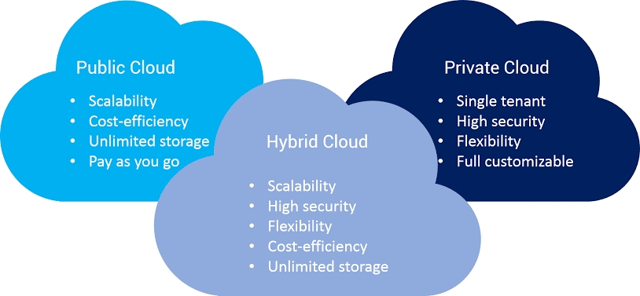

Slide 62
III. Types of clouds (cont..)
Public clouds: The services offered are made available to anyone, from anywhere, and at any time through the Internet.
From a structural point of view they are a distributed system, most likely composed of one or more datacenters connected together, on top of which the specific services offered by the cloud are implemented.
Any customer can easily sign in with the cloud provider, enter credentials and billing details, and use the services offered.
They offer solutions for minimizing IT infrastructure costs and serve as a viable option for handling peak loads on the local infrastructure.

Slide 63
III. Types of clouds (cont..) Public clouds:
A fundamental characteristic of public clouds is multitenancy.
A public cloud is meant to serve a multitude of users, not a single customer. Any customer requires a virtual computing environment that is separated, and most likely isolated, from other users.
This is a fundamental requirement to provide effective monitoring of user activities and guarantee the desired performance and the other QoS attributes negotiated with users.
QoS management is a very important aspect of public clouds.

Slide 64
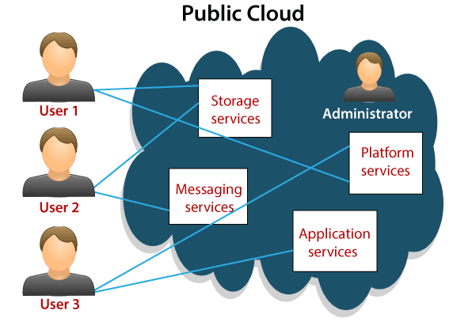

Slide 65
III. Types of clouds (cont..) Public clouds:
A public cloud can offer any kind of service: infrastructure, platform, or applications.
For example, Amazon EC2 is a public cloud that provides infrastructure as a service;
Google AppEngine is a public cloud that provides an application development platform as a service;
and SalesForce.com is a public cloud that provides software as a service.

Slide 66
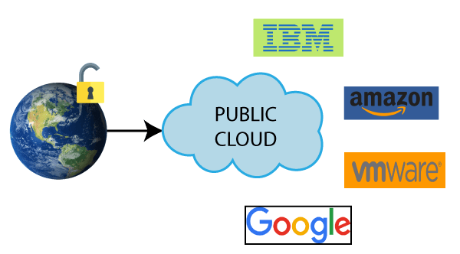

Slide 67
III. Types of clouds (cont..) Public clouds:
From an architectural point of view there is no restriction concerning the type of distributed system implemented to support public clouds.
Public clouds can be composed of geographically dispersed datacenters to share the load of users and better serve them according to their locations.
For example, Amazon Web Services has datacenters installed in the United States, Europe, Singapore, and Australia; they allow their customers to choose between three different regions: us-west-1, us-east-1, or eu-west-1.
Such regions are priced differently and are further divided into availability zones, which map to specific datacenters.
According to the specific class of services delivered by the cloud, a different software stack is installed to manage the infrastructure: virtual machine managers, distributed middleware, or distributed applications.

Slide 68
III. Types of clouds (cont..) Public clouds :
Public clouds are appealing and provide a viable option to cut IT costs and reduce capital expenses, but they are not applicable in all scenarios.
For example, a very common critique to the use of cloud computing in its recognized implementation is the loss of control.
In particular, institutions such as government and military agencies will not consider public clouds as an option for processing or storing their sensitive data.
The risk of a breach in the security infrastructure of the provider could expose such information to others; this could simply be considered unacceptable.

Slide 69
AWS Global Infrastructure
The Most Secure, Extensive, and Reliable Global Cloud Infrastructure, for all your applications.

Slide 70
AWS Global Infrastructure
The AWS Global Cloud Infrastructure is the most secure, extensive, and reliable cloud platform, offering over 200 fully featured services from data centers globally.
Whether you need to deploy your application workloads across the globe in a single click, or you want to build and deploy specific applications closer to your end-users with single-digit millisecond latency, AWS provides you the cloud infrastructure where and when you need it.

Slide 71
AWS Global Infrastructure
With millions of active customers and tens of thousands of partners globally, AWS has the largest and most dynamic ecosystem.
Customers across virtually every industry and of every size, including start-ups, enterprises, and public sector organizations, are running every imaginable use case on AWS.

Slide 72
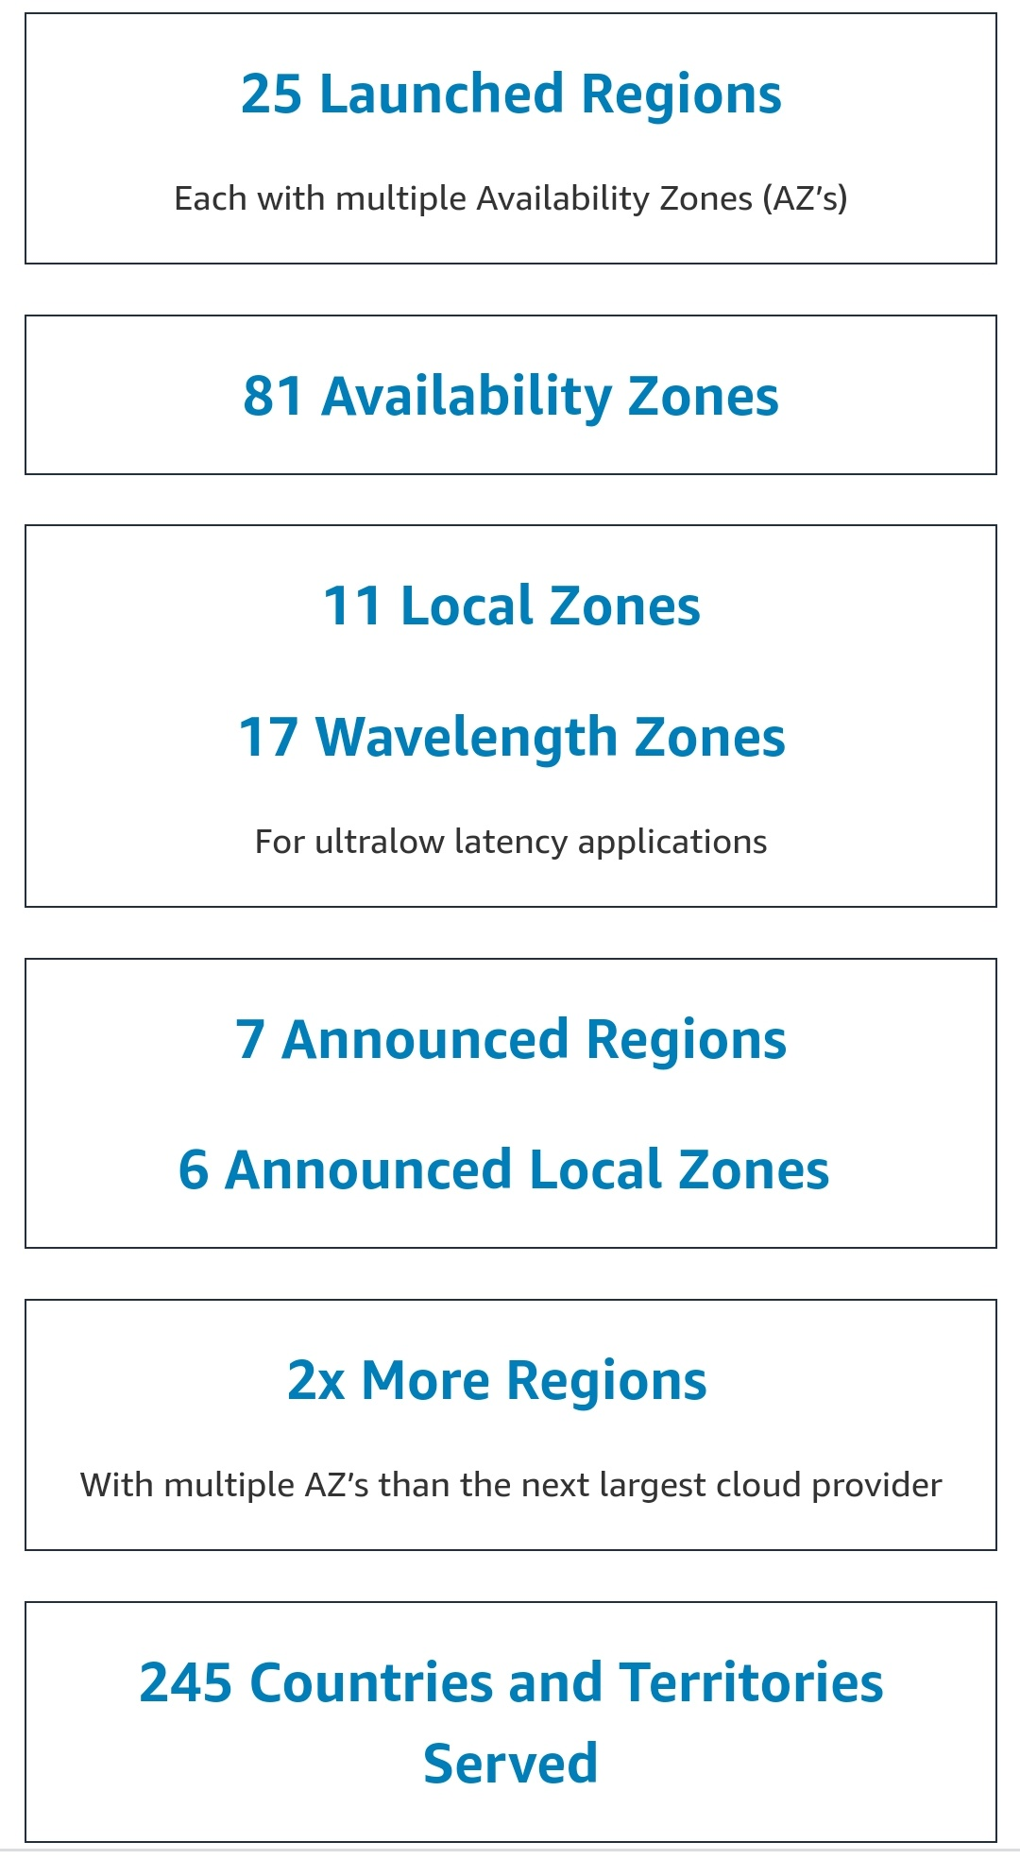

Slide 73
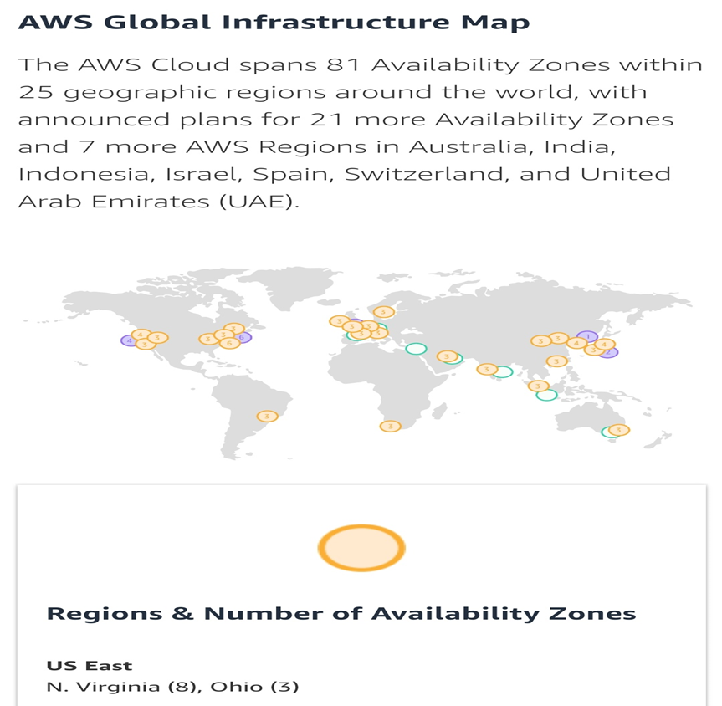

Slide 74
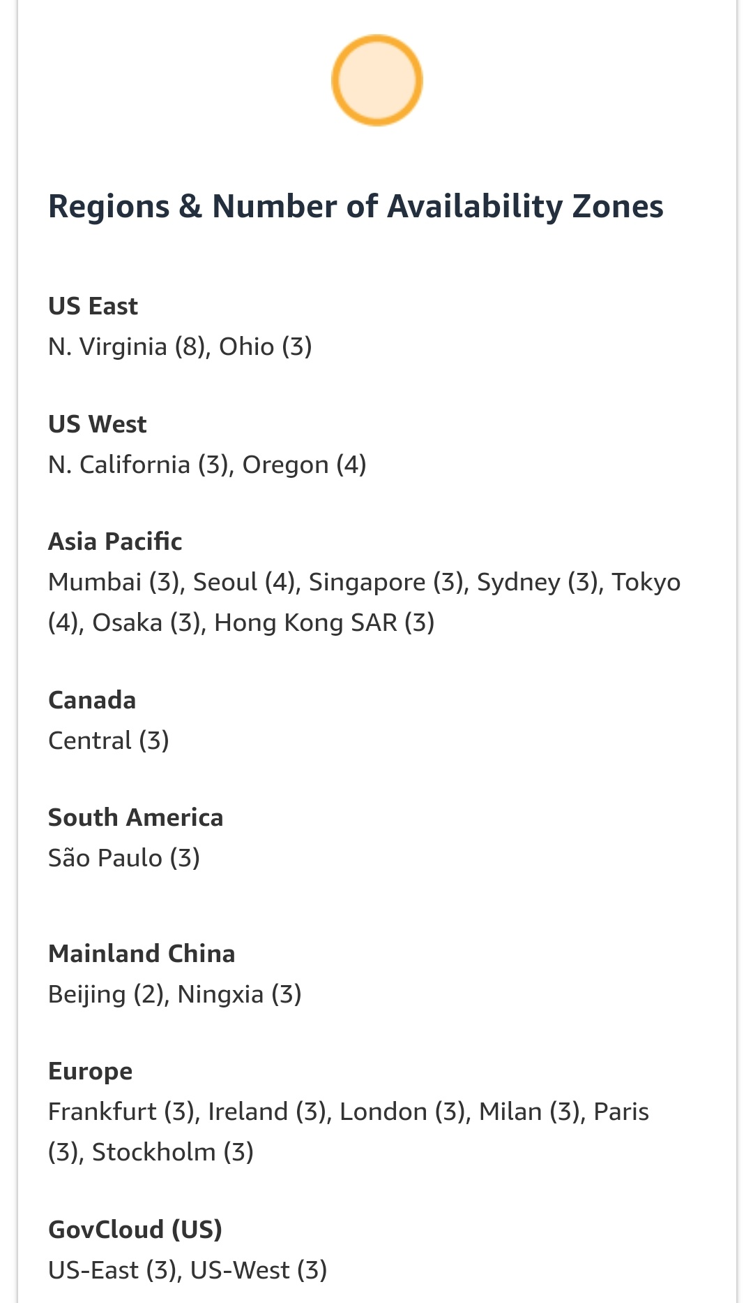

Slide 75
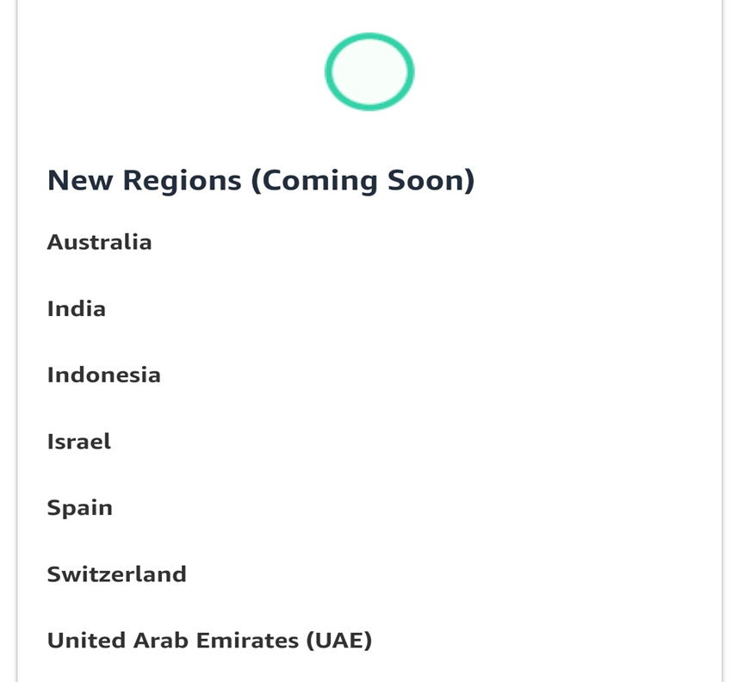

Slide 76
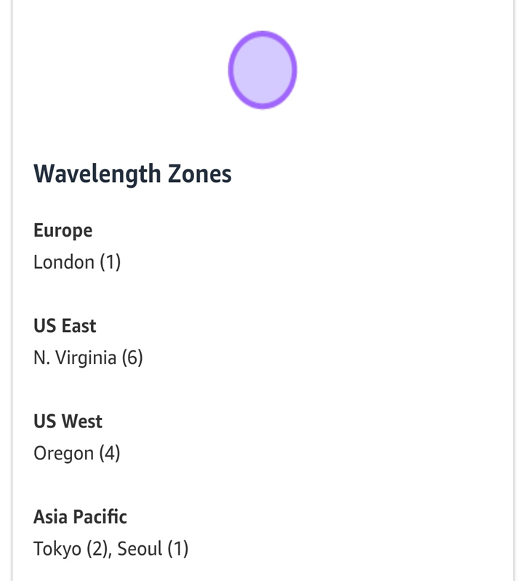

Slide 77
Private Clouds
Private clouds have the advantage of keeping the core business operations in-house by relying on the existing IT infrastructure and reducing the burden of maintaining it once the cloud has been set up.
In this scenario, security concerns are less critical, since sensitive information does not flow out of the private infrastructure.

Slide 78
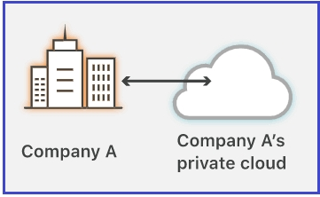
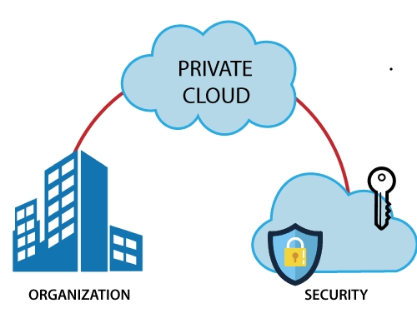

Slide 79
Delivering in-house cloud computing solutions for enter-prises highlighted some of the key advantages of using a private cloud computing infrastructure:
1. Customer information protection: Despite assurances by the public cloud leaders about security, few provide satisfactory disclosure or have long enough histories with their cloud offerings to provide warranties about the specific level of security put in place on their systems.
In-house security is easier to maintain and rely on.

Slide 80
2. Infrastructure ensuring SLAs: Quality of service implies specific operations such as appropriate clustering and failover, data replication, system monitoring and maintenance, disaster recovery and other uptime services can be proportional to the application needs.
Although public cloud vendors provide some of these features, not all of them are available as needed.

Slide 81
3. Compliance with standard procedures and operations:
If organizations are subject to third-party compliance standards, specific procedures have to be put in place when deploying and executing applications.
This could be not possible in the case of the virtual public infrastructure.
All these aspects make the use of cloud-based infrastructures in private premises an interesting option.

Slide 82
From an architectural point of view, private clouds can be implemented on more heterogeneous hardware: They generally rely on the existing IT infrastructure already deployed on the private premises. This could be a datacenter, a cluster, an enterprise desktop grid, or a combination of them.
Different options can be adopted to implement private clouds. Figure 4.4 provides a comprehensive view of the solutions together with some reference to the most popular software used to deploy private clouds.

Slide 83
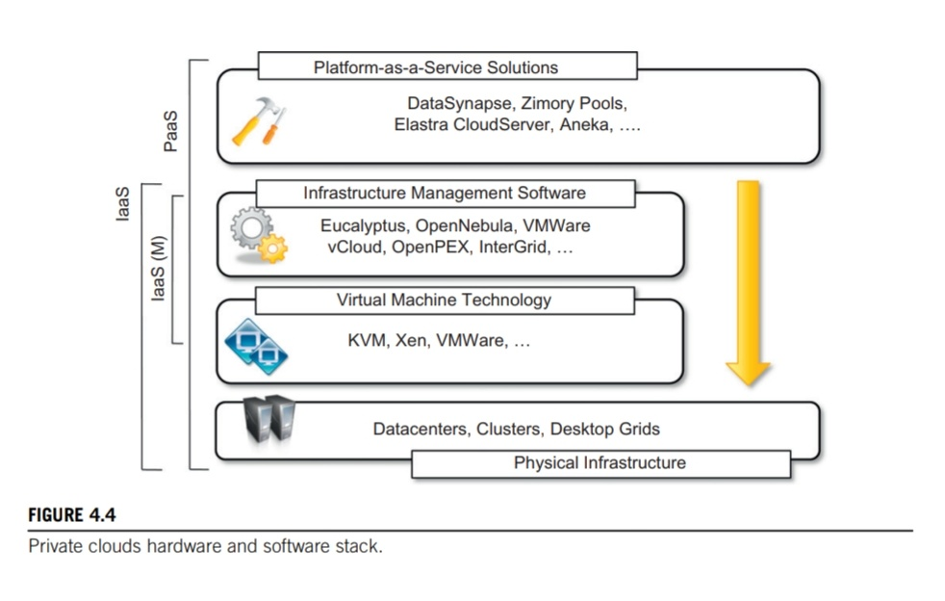

Slide 84
At the bottom layer of the software stack, virtual machine technologies such as Xen, KVM and Vmware serve as the foundations of the cloud.
Virtual machine management technologies such as Vmware vCloud, Eucalyptus and OpenNebula can be used to control the virtual infrastructure and provide an IaaS solution.
Eucalyptus provides full compatibility with Amazon Web Services interfaces and supports different virtual machine technologies such as Xen, KVM, and Vmware.
Like Eucalyptus, OpenNebula is an open-source solution for virtual infrastructure management that supports KVM, Xen, and Vmware, which has been designed to easily integrate third-party IaaS providers.

Slide 85
Solutions that rely on the previous virtual machine managers and provide added value are OpenPEX and InterGrid.
OpenPEX (Provisioning and Execution System for VMs) is Web-based system that allows the reservation of virtual machine instances and is designed to support different back ends (at the moment only the support for Xen is implemented).
InterGrid provides added value on top of OpenNebula and Amazon EC2 by allowing the reservation of virtual machine instances and managing multi-administrative domain clouds.
PaaS solutions can provide an additional layer and deliver a high-level service for private clouds.
Among the options available for private deployment of clouds we can consider DataSynapse, Zimory Pools, Elastra, and Aneka.
DataSynapse is a global provider of application virtualization software.

Slide 86
DataSynapse provides a flexible environment for building private clouds on top of datacenters.
Elastra Cloud Server is a platform for easily configuring and deploying distributed application infrastructures on clouds.
Zimory provides a software infrastructure layer that automates the use of resource pools based on Xen, KVM, and Vmware virtualization technologies.
Zimory allows creating an internal cloud composed of sparse private and public resources and provides facilities for migrating applications within the existing infrastructure.

Slide 87
Aneka is a software development platform that can be used to deploy a cloud infrastructure on top of heterogeneous hardware: datacenters, clusters, and desktop grids.
Aneka also provides a pluggable service-oriented architecture that’s mainly devoted to supporting the execution of distributed applications with different programming models: bag of tasks, MapReduce, and others.
Private clouds can provide in-house solutions for cloud computing, but if compared to public clouds they exhibit more limited capability to scale elastically on demand.

Slide 88
Hybrid or heterogeneous clouds
Community clouds

Slide 89
Economics of the cloud
The main drivers of cloud computing are economy of scale and simplicity of software delivery and its operation.
In fact, the biggest benefit of this phenomenon is economic (cost-effective): the pay-as-you-go model offered by cloud providers. In particular, cloud computing allows:
Reducing the capital costs associated with the IT infrastructure
Eliminating the lifetime costs associated with IT capital assets
Replacing software licensing with subscriptions
Cutting the maintenance and administrative costs of IT resources

Slide 90
Economics of the cloud
A capital cost is the cost occurred in purchasing an asset that is useful in the production of goods or the execution of services. Capital costs are one-time expenses that are generally paid up-front (direct) and that will contribute over the long term to generate profit.
The IT infrastructure and the software are capital assets because enterprises require them to conduct their business.
In the case of a small startup, it is possible to completely control the cloud for many aspects, such as:
• IT infrastructure
• Software development
• CRM and ERP

Slide 91
Economics of the cloud
In terms of the pricing models introduced by cloud computing, we can distinguish three different strategies that are adopted by the providers:
Tiered pricing. In this model, cloud services are offered in several tiers, each of which offers a fixed computing specification and SLA at a specific price per unit of time. This model is used by Amazon for pricing the EC2 service, which makes available different server configurations in terms of computing capacity (CPU type and speed, memory) that have different costs per hour.
Per-unit pricing. This model is more suitable to cases where the principal source of revenue for the cloud provider is determined in terms of units of specific services, such as data transfer and memory allocation. In this scenario customers can configure their systems more efficiently according to the application needs. This model is used, for example, by GoGrid, which makes customers pay according to RAM/hour units for the servers deployed in the GoGrid cloud.
Subscription-based pricing. This is the model used mostly by SaaS providers in which users pay a periodic subscription fee for use of the software or the specific component services that are integrated in their applications.

Slide 92
Open challenges
Still in its early stages, cloud computing presents many challenges for industry and academia.
In this section, we highlight the most important ones: definition, the interoperation between different clouds, the creation of standards, security, scalability, fault tolerance, and organizational aspects.

Slide 93
Open challenges
Cloud definition: As discussed earlier, there have been several attempts made to define cloud computing and to provide a classification of all the services and technologies identified as such. One of the most comprehensive validations is noted in the NIST working definition of cloud computing.
It characterizes cloud computing as on-demand self-service, broad network access, resource-pooling, rapid elasticity, and measured service; classifies services as SaaS, PaaS, and IaaS; and categorizes deployment models as public, private, community, and hybrid clouds. The view is in line with our discussion and shared by many IT practitioners and academics.

Slide 94
Open challenges
Despite the general agreement on the NIST definition, there are alternative classifications for cloud services. L David, founder of BlueMountains Labs, provides a more detailed classification, which follows 10 different classes and better suits the vision of cloud computing within the enterprise.
A different approach has been taken at the University of California, Santa Barbara (UCSB), which proceeds from the XaaS concept for cloud computing. In their work the concept of a cloud is divided into five main layers: applications, software environments, software infrastructure, software kernel, and hardware.

Slide 95
Open challenges
These characterizations and classifications reflect what is meant by cloud computing at the present time, but being in its initial stages the phenomenon is constantly evolving.

Slide 96
Open challenges
Cloud interoperability and standards: Cloud computing is a service-based model for delivering IT infrastructure and applications like utilities such as power, water, and electricity.
To fully understand this goal, introducing standards and allowing interoperability between solutions offered by different vendors are objectives of fundamental importance.
Cloud interoperability refers to the ability of the systems to work efficiently and collaborate effectively across different cloud platforms.
Vendor lock-in constitutes one of the major strategic barriers against the seamless adoption of cloud computing at all the stages.

Slide 97
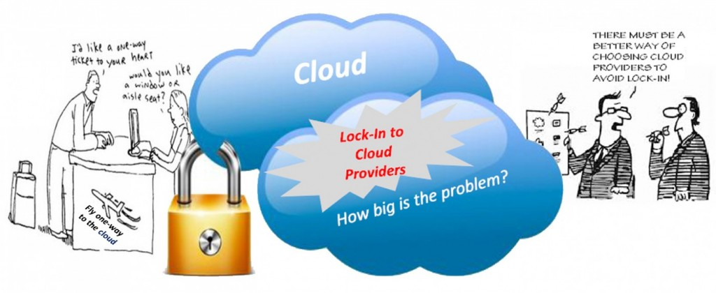
Vendor lock-in
The vendor lock-in problem in cloud computing is the situation where customers are dependent (i.e. locked-in) on a single cloud provider technology implementation and cannot easily move in the future to a different vendor without significant costs, legal constraints, or technical mismatches.

Slide 98
Open challenges
Cloud interoperability and standards:
The current state of standards and interoperability in cloud computing be similar to the early Internet era, when there was no common agreement on the protocols and technologies used and each organization had its own network.
However the first steps toward a standardization process have been made, and a few organizations, such as the Cloud Computing Interoperability Forum (CCIF), the Open Cloud Consortium, and the DMTF Cloud Standards Incubator, are leading the path.

Slide 99
Open challenges
Cloud interoperability and standards:
Another interesting initiative is the Open Cloud Manifesto, which represents the point of view of various stakeholders on the benefits of open standards in the field.
The Open Virtualization Format (OVF) is an attempt to provide a common format for storing the information and metadata describing a virtual machine image.

Slide 100
Open challenges
Scalability and fault tolerance:
The ability to scale on-demand constitutes one of the most attractive features of cloud computing. Clouds allow scaling beyond the limits of the existing in-house IT resources, whether they are infrastructure (compute and storage) or applications services.
To implement such a capability, the cloud middleware has to be designed with the principle of scalability along different dimensions in mind—for example, performance, size, and load.

Slide 101
Open challenges
Scalability and fault tolerance:
Hence, the challenge in this case is designing highly scalable and fault-tolerant systems that are easy to manage and at the same time provide competitive performance.

Slide 102
Open challenges
Security, trust, and privacy:
Security, trust, and privacy issues are major obstacles for massive adoption of cloud computing.
The traditional cryptographic technologies are used to prevent data tampering and access to sensitive information.
The massive use of virtualization technologies exposes the existing system to new threats, which previously were not considered applicable.
In this case, what is experienced is a lack of control over the environment in which the application is executed, which is made possible by controlling the cloud.

Slide 103
Open challenges
Organizational aspects:
Cloud computing introduces a significant change in the way IT services are consumed and managed. More precisely, storage, compute power, network infrastructure, and applications are delivered as metered services over the Internet.
This introduces a billing model that is new within typical enterprise IT departments, which requires a certain level of cultural and organizational process development.
In particular, a wide acceptance of cloud computing will require a significant change to business processes and organizational boundaries.
Some interesting questions arise in considering the role of the IT department in this new scenario. In particular, the following questions have to be considered:

Slide 104
Open challenges
Organizational aspects:
What is the new role of the IT department in an enterprise that completely or significantly relies on the cloud?
How will the compliance department perform its activity when there is a considerable lack of control over application workflows?
What are the implications (political, legal, etc.) for organizations that lose control over some aspects of their services?
What will be the perception of the end users of such services?

Slide 105
Summary (Chapter I)
In this chapter, we discussed the vision and opportunities of cloud computing along with its characteristics and challenges.
The cloud computing paradigm emerged as a result of the maturity and convergence of several of its supporting models and technologies, namely distributed computing, virtualization, Web 2.0, service orientation, and utility computing.

Slide 106
Summary (Chapter I)
There is no single view on the cloud phenomenon. Throughout the book, we explore different definitions, interpretations, and implementations of this idea.
The only element that is shared among all the different views of cloud computing is that cloud systems support dynamic provisioning of IT services (whether they are virtual infrastructure, runtime environments, or application services) and adopts a utility-based cost model to price these services.
This vision is what inspires the Cloud Computing Reference Model. This model identifies three major market segments (and service offerings) for cloud computing: Infrastructure-as-a-Service (IaaS), Platform-as-a-Service (PaaS), and Software-as-a-Service (SaaS). These segments directly map the broad classifications of the different type of services offered by cloud computing.

Slide 107
Summary (Chapter IV)
In this chapter we discussed the fundamental characteristics of cloud computing and introduced reference architecture for classifying and organizing cloud services. To best sum up the content of this chapter, we can recall the NIST working definition of cloud computing, which outlines the fundamental aspects of this phenomenon as follows:
Five essential characteristics. In-demand self-service, broad network access, resource pooling, rapid elasticity, and measured service.
Three service models. Software-as-a-Service (SaaS), Platform-as-a-Service (PaaS), and Infrastructure-as-a-Service (IaaS).
Four deployment models. Public clouds, private clouds, community clouds, and hybrid clouds.

Slide 108
Summary (Chapter IV)
The major driving force for rapid adoption of cloud computing are the economics and the simplicity of software delivery and operation. Cloud computing presents considerable opportunity to increase the profits of enterprises by reducing capital costs of IT assets and transforming them into operational costs. For these reasons we have also discussed the economic and cost models introduced with cloud computing.
Although cloud computing has been rapidly adopted in industry, there are several open research challenges in areas such as management of cloud computing systems, their security, and social and organizational issues. There is significant room for advancement in software infrastructure and models supporting cloud computing.

Slide 109
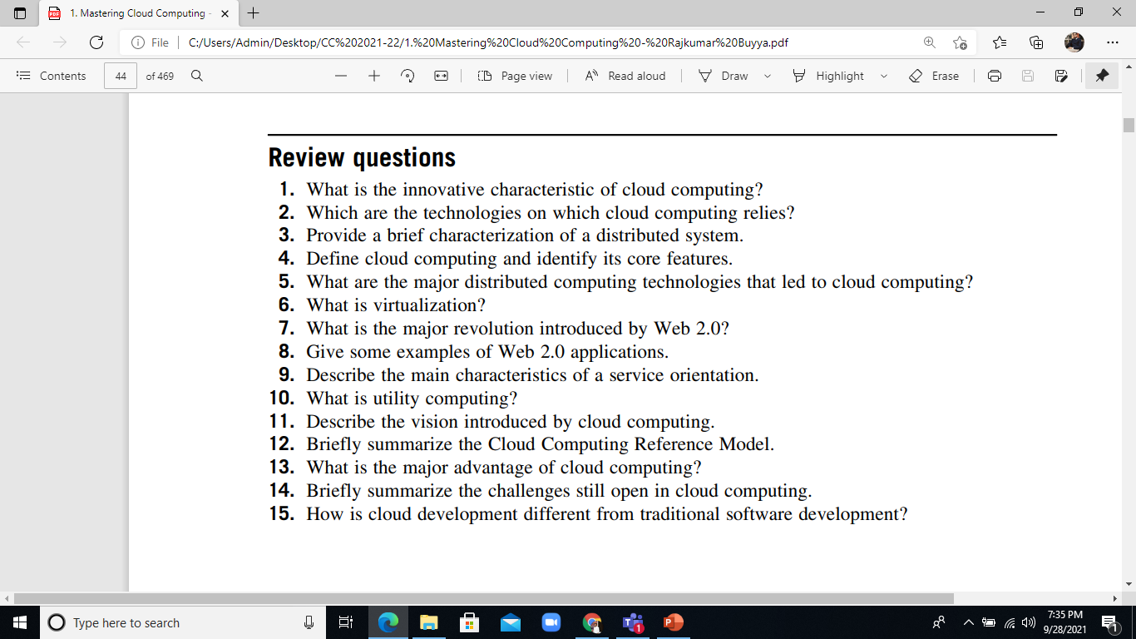

Slide 110
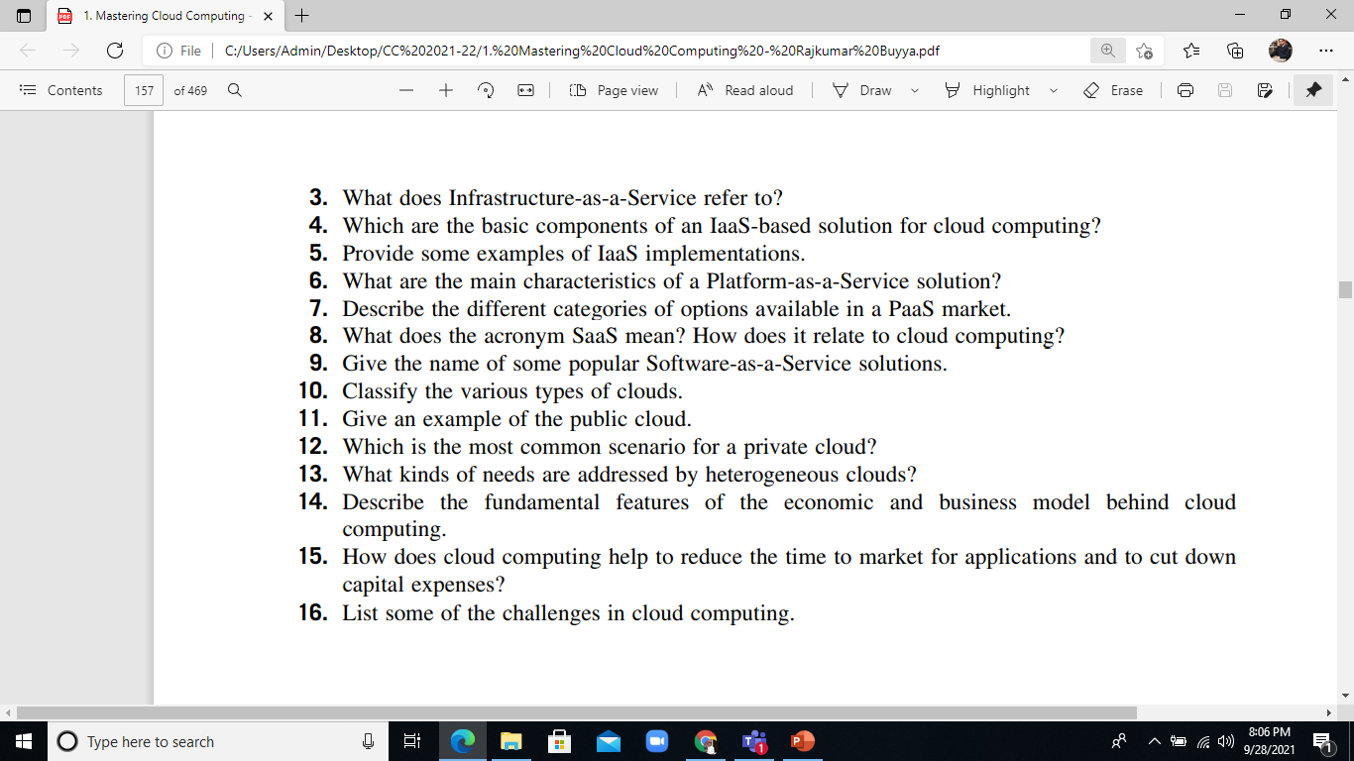
Review questions
1. What does the acronym XaaS stand for?
2. What are the fundamental components introduced in the cloud reference model?

